Slide 1

Transaction Labelling Service Architecture
Objective: Develop a service to automatically and accurately label transactions using data provided my pre-existing transaction processor API for Chorus

Slide 2

Project Background – Context and Data Source
Context: Automated transaction labelling to improve financial data analysis, budgeting and user insights.
Data Source: Pre-existing transaction processor API and transaction records from Chorus with fields like Transaction ID, accounts, bank codes, amount and narration

Slide 3
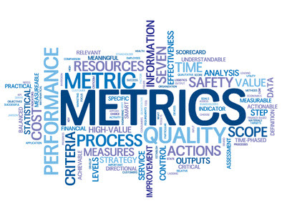
Requirements and Goal – Primary Requirement and Key Metrics
Primary Requirement: Classify transaction accurately incorporating a feedback loop to enhance classification over time.
Key Metrics: Target high initial accuracy, scalable performance and real-time response for optimal user experience.
This Photo by Unknown Author is licensed under CC BY-SA

Slide 4

Data Structure Enhancement for Improved Accuracy – Additional Data Fields for Labelling
Transaction Metadata: Timestamp, location data, and currency code to increase context-based labelling accuracy.
Enhanced Narration Processing: Use NLP and Named Entity Recognition(NER) to extract key terms and entities from narration.

Slide 5
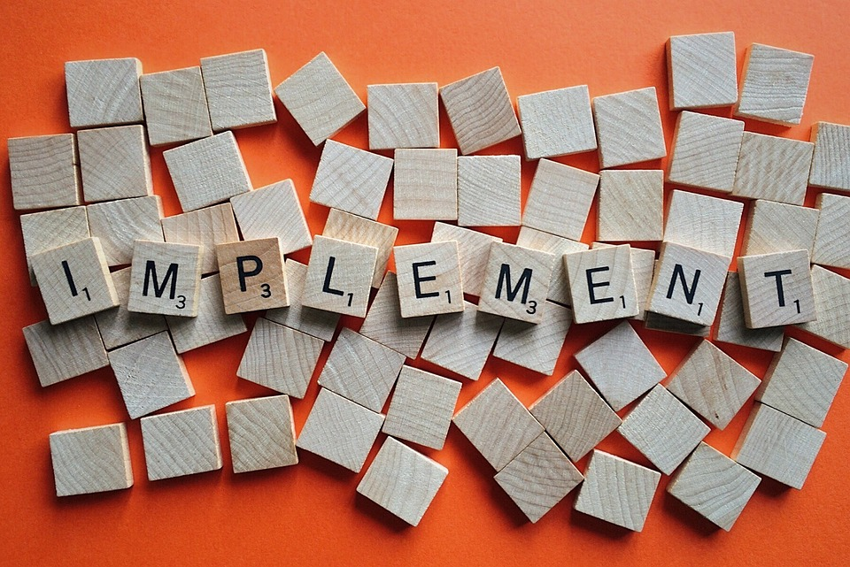
Implementation Plan – Roadmap for Development
Data Collection and Processing: At this stage, we have a few options, we could push transaction records as soon as they are processed and stored in the database to Apache Kafka. We could also normalize the data by adding more fields that will improve the accuracy of the model
Baseline Model Training: At this stage, we perform preliminary model training using basic categorization technique and ML models. We can begin training with models like Naïve Bayes and Decision Trees, then consider advanced models like Transformers

Slide 6
Implementation Plan Contd – Roadmap for Development
Model Refinement with Feedback: Because we want to achieve a high accuracy, this is the stage where we will incorporate user feedback to improve model performance. This will be done iteratively over a specified interval
Scalable Deployment: At this stage, we deploy the model on a scalable architecture with caching for high frequency transactions

